Slide 1

Supporting your child in Mathematics

Slide 2
Mathematics in KS4
About us and the curriculum at Key Stage 4
Higher/Foundation and GCSE Grades
Assessments
Homework
Supporting at Home
Useful Resources

Slide 3
About us
One the most successful maths departments in the North East.
35.4% of pupils achieved a grade 7 or above in 2024/25
81.4% of pupils achieved a grade 4 or above in 2024/25
15 experienced maths specialist teachers
High retention of pupils going on to study A-level maths

Slide 4
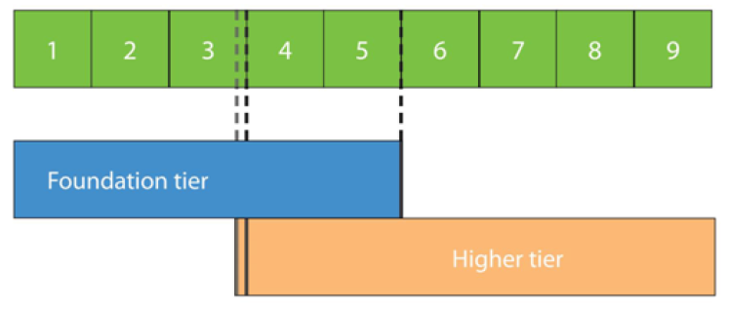
GCSE Tiers of Entry
We aim to enter pupils for the tier of entry that gives them the best chance of their highest possible grade
Entries are not made until after January Mocks in Year 11. Assessments are carried out in year 10 and Year 11 to ensure pupils are covering the most appropriate work to support their attainment in the final GCSE exams – set changes are made throughout to ensure the most appropriate support is available.

Slide 5
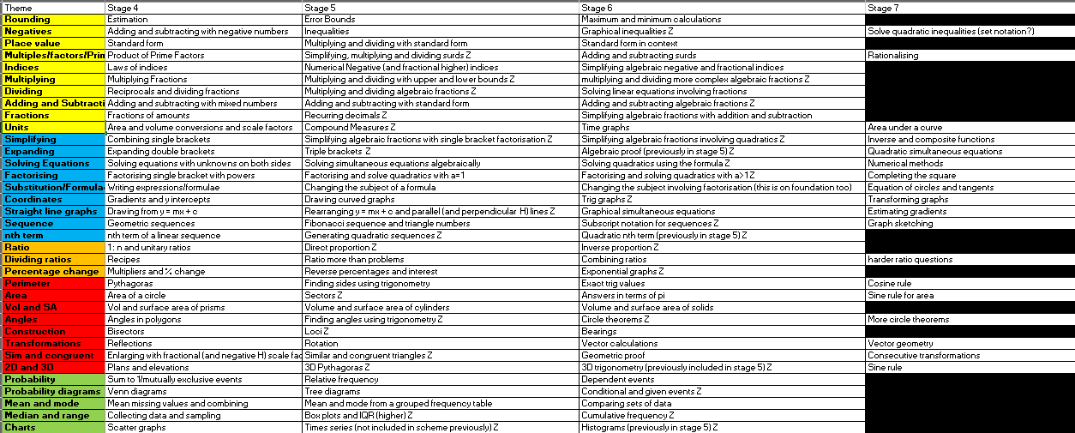
KS4 Curriculum Content (year 10 and year 11)

Slide 6
Assessments and mocks
Assessments take two forms, formative and summative.
Formative assessments are used every two weeks throughout year 10 to assess how pupils are progressing through the curriculum
Formative assessments are generally ungraded and do not usually contain a ‘mark’, pupils are encouraged to reflect on their knowledge rather than attainment (using a feedback/review sheet).
In year 11 these “formative” assessments become less frequent as we begin to practice more exam papers. We move to an assessment that supports the revision process.
Summative assessments, sat three times during year 10 (Autumn, Spring and Summer), use a modified GCSE paper at the start of the year, moving on to full papers at the end of Year 10.
In year 11 there are 4 full GCSE assessments, one in Autumn, two during the January Mocks, and one in Spring

Slide 7
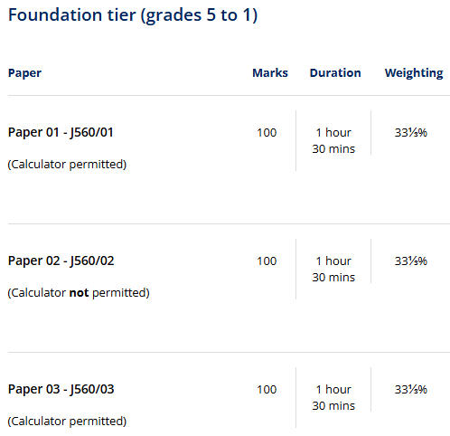
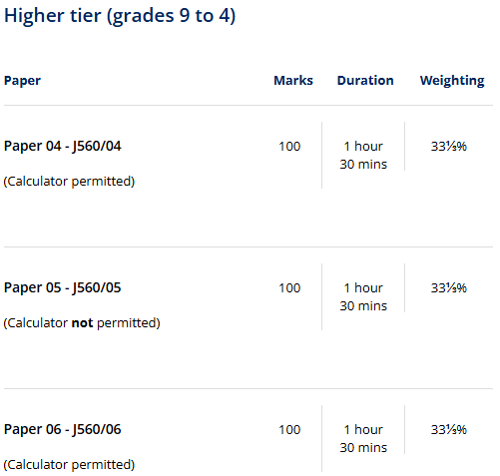
Final Exam Structure
We enter pupils for the OCR GCSE Mathematics Exam (code J560).
Examination is across three 90minute papers:

Slide 8
AQA Further Maths
Only pupils who achieve a grade 8 or 9 in January mocks in year 11 will be entered for this extra exam
It will be an opt-in process, with the majority of the teaching taking place in Period 7 sessions.
Some of the “overlap topics” will be taught in mainstream lessons to pupils covering the Higher syllabus.
Helps bridge the gap to A-level but is not essential.

Slide 9
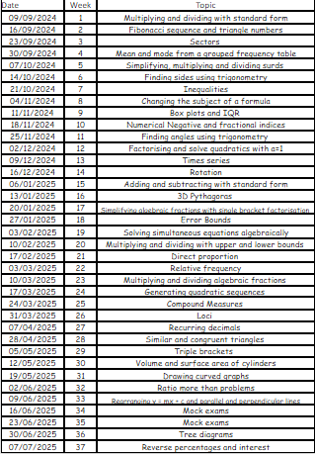
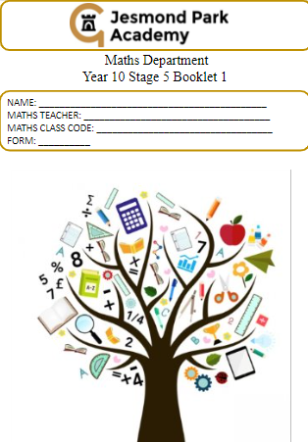
Back of the Homework Booklet

Slide 10
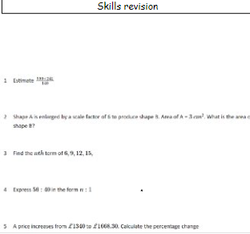
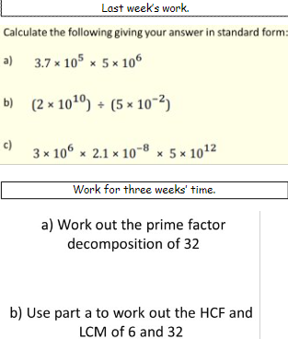
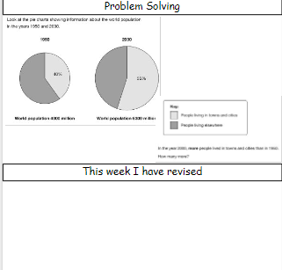
Homework – At Year 10
All pupils have a homework booklet that supports their progression through our curriculum
Questions relating to the previous week’s work,
Questions to prompt recall of earlier skills
Questions to promote problem solving skills (and resilience!)
Class teachers set homework each week from the booklet – reminder set on Frog

Slide 11
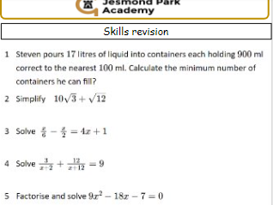
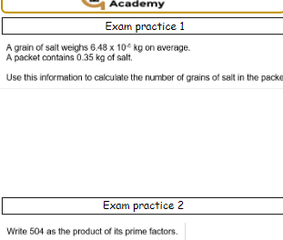
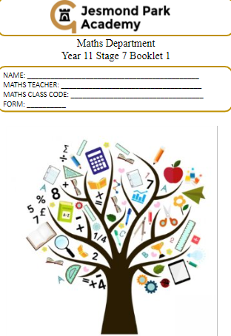
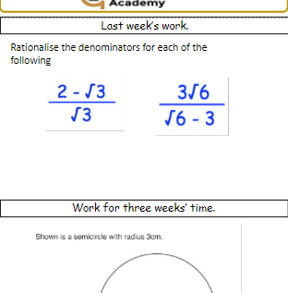
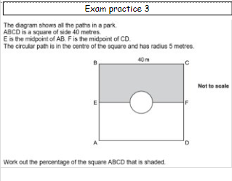
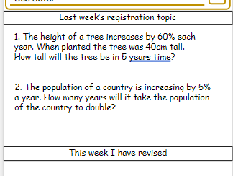
Homework (and form time) – At Year 11
All pupils have a booklet that is used for homework and during registration
They complete a supported revision programme during registration on Tuesday and Thursday
There are additional “Exam Practice” homework questions in the year 11 booklet to ensure breadth of coverage in the build up to the final exams – “little and often!”

Slide 12
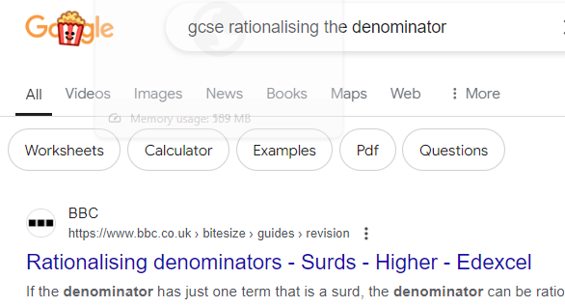
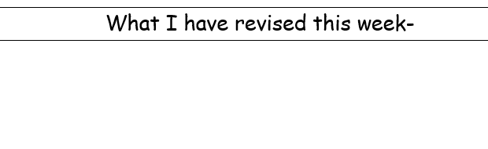
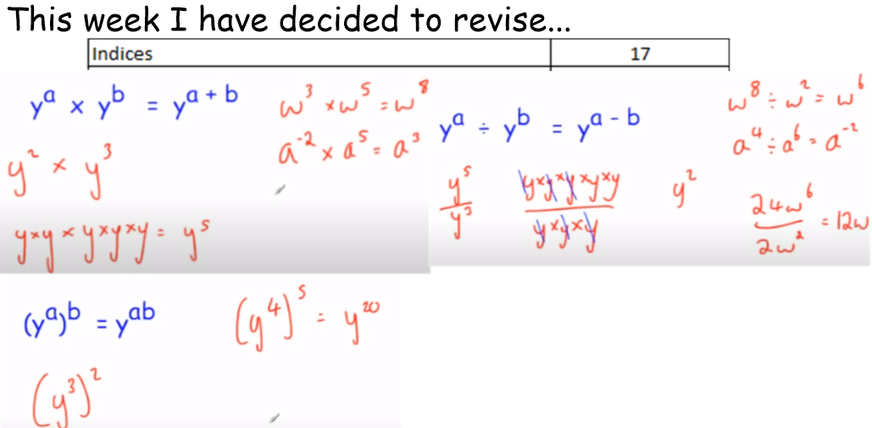
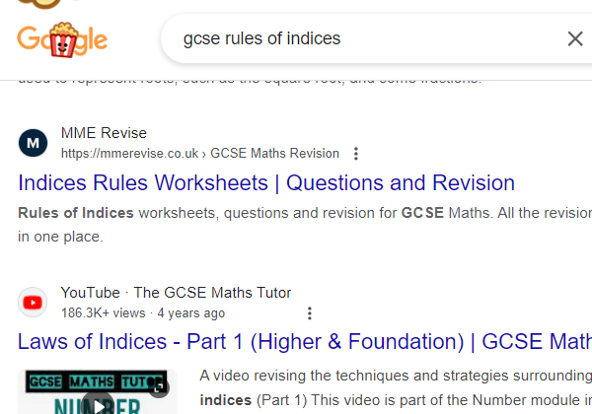
Support at home
- Make homework as purposeful as possible

Slide 13
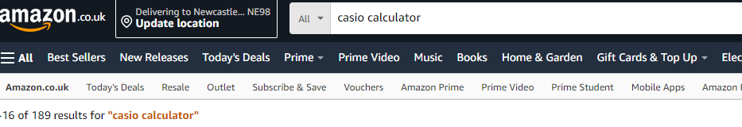
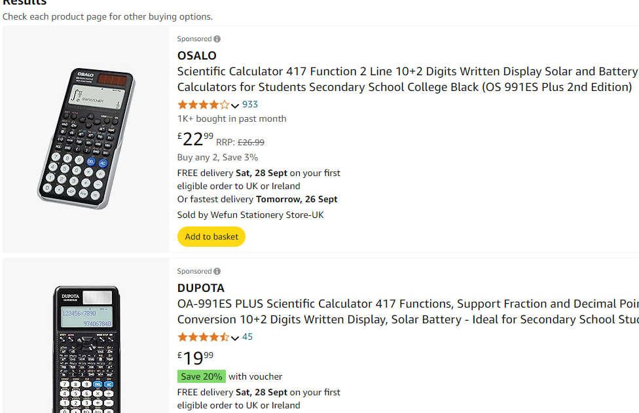

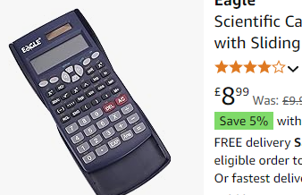
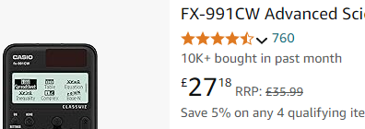
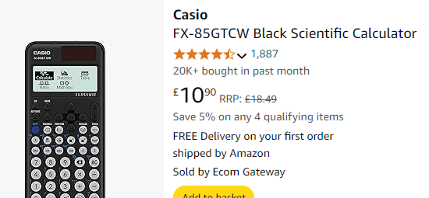
Useful resources
A calculator! (Casio FX-83, FX-85, FX-991)
Calculator familiarity is key at GCSE
P
Only get “991” if
likely to do
A-level:
P

Slide 14
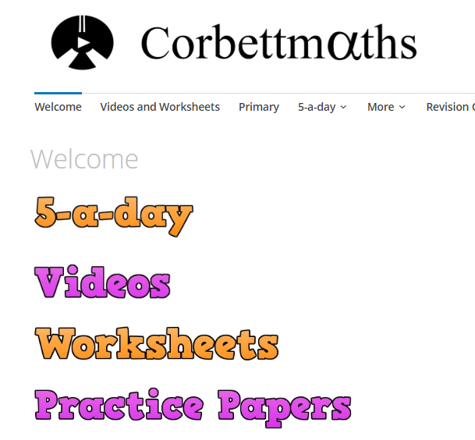
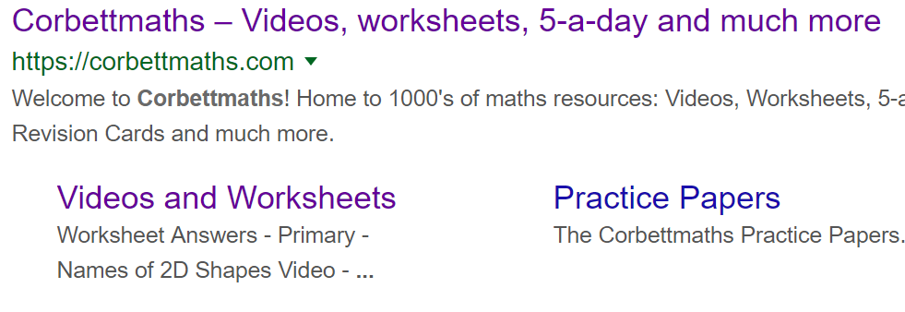
Useful resources – list on next page (this will be sent out)
To support your child at home we encourage the use of Corbett Maths, Maths Genie and GCSE Bitesize
Free websites with video guides and practice worksheets

Slide 15
Useful Maths Revision Websites
https://www.drfrost.org/revision/papers
*register for a free account to record progress
www.examq.co.uk/qualification/2
www.onmaths.com/our-top-top-topics
www.1stclassmaths.com
www.mathslinks.co.uk/gcse-questions-by-topic
www.gcsemathsquestions.co.uk
www.savemyexams.com/gcse
www.mathsgenie.co.uk

Slide 16
Thank you

