Slide 1

Supporting your child in Mathematics

Slide 2
Mathematics in KS3
About the curriculum
Homework
Assessments
Supporting the Transition to GCSE
Useful Resources

Slide 3
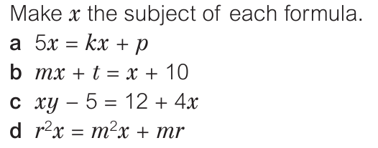
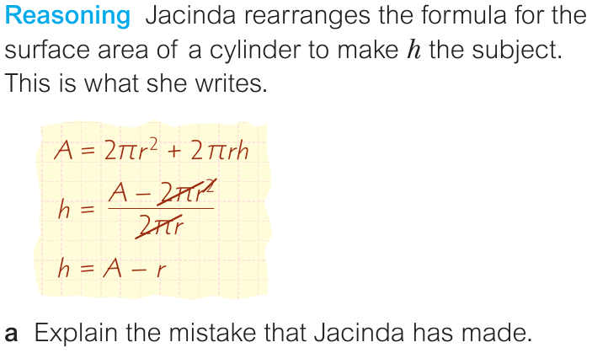
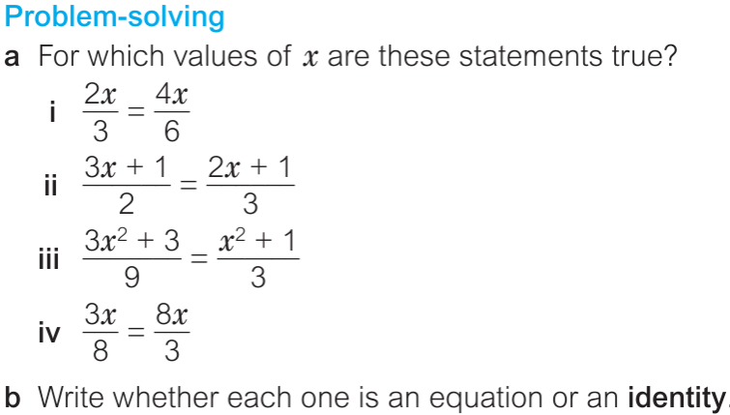
About the curriculum
All of our lessons have the same underpinning principles
  building on previous learning
  securing knowledge
  gaining fluency
  promoting reasoning
  developing problem solving skills

Slide 4
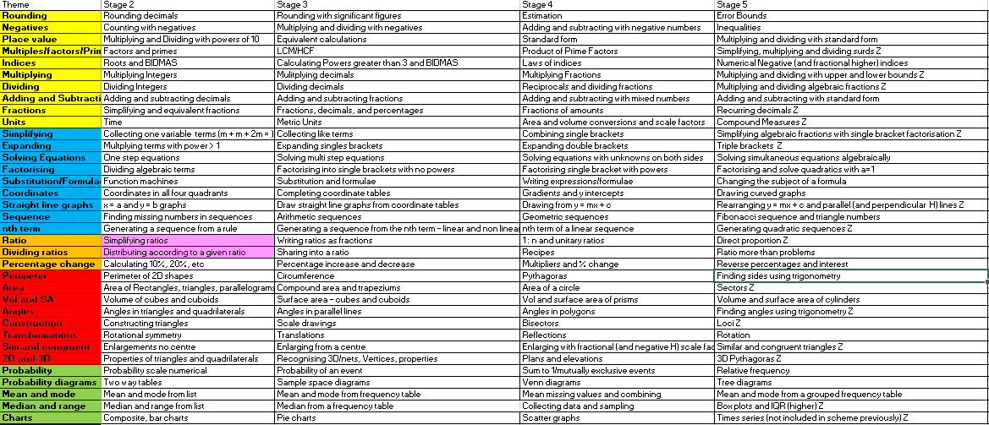
KS3 Curriculum Content (year 8 and year 9)
Emerging → … →Excelling

Slide 5

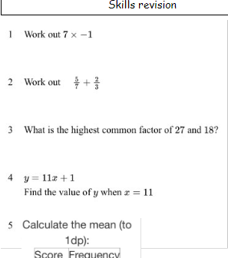
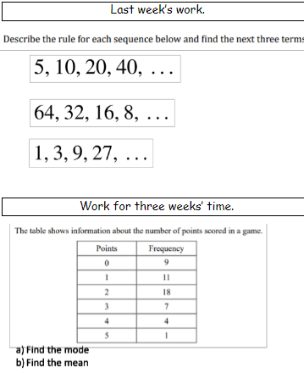
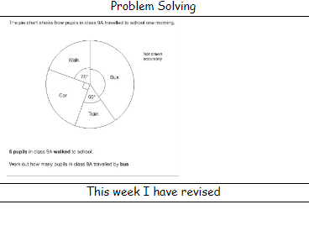
Homework
All pupils have a homework booklet that supports their progression through our curriculum
Questions relating to the previous week’s work,
Questions to prompt recall of earlier skills
Questions to promote problem solving skills and resilience
Class teachers set homework each week from the booklet – reminder set on Frog

Slide 6
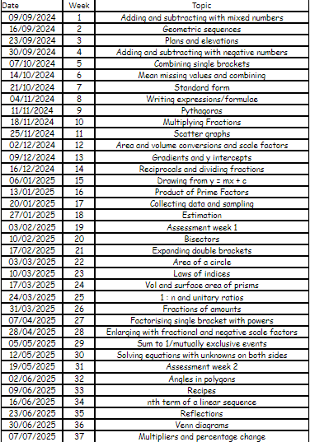
Back of the Homework Booklet

Slide 7
Assessments
Assessments take two forms, formative and summative.
Formative assessments are used every two weeks to assess how pupils are progressing through the whole curriculum
Formative assessments are generally ungraded and do not usually contain a ‘mark’, pupils are encouraged to reflect on their knowledge rather than attainment (using a feedback/review sheet).
Summative assessments, sat three times during the year (Autumn, Spring and Summer), use a bespoke paper based on Age Related Expectations
An overall Age Related Grade is used in Key Stage 3 to track progress through our curriculum.

Slide 8
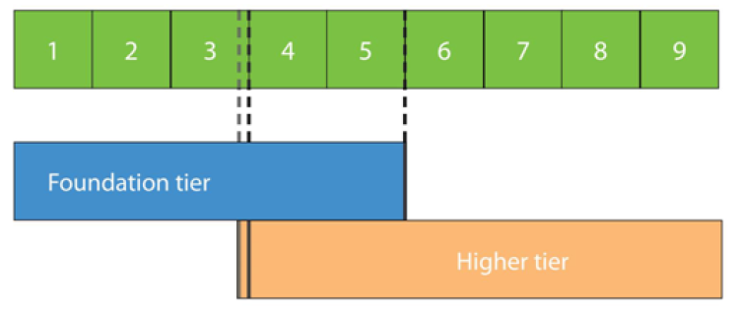
GCSE transition
Generally, pupils who are “Excelling” or “Exceeding” at the end of year 9 will go on to follow the Higher GCSE course, whereas pupils who are “Emerging” or “Developing” going on to follow “Foundation”. Pupils who are “Achieving” will often begin on Higher with some continuing on that path in Year 11 and others moving to Foundation
This is not set in stone, assessments are carried out in year 10 to ensure pupils are covering the most appropriate work to support their attainment in the final GCSE exams.

Slide 9
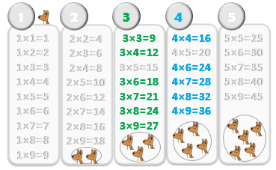
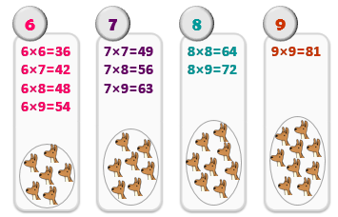
Support at home
Assuming you know the 1, 2, 5, and 10 ten times tables,
there are only(!) 21 multiplication facts you need to master…

Slide 10
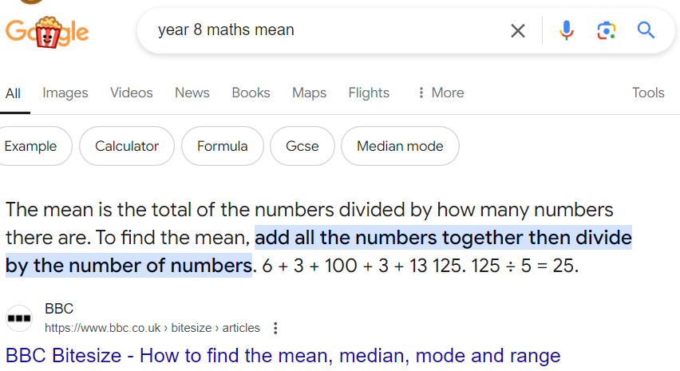
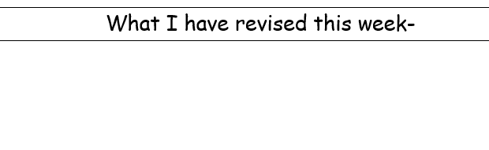
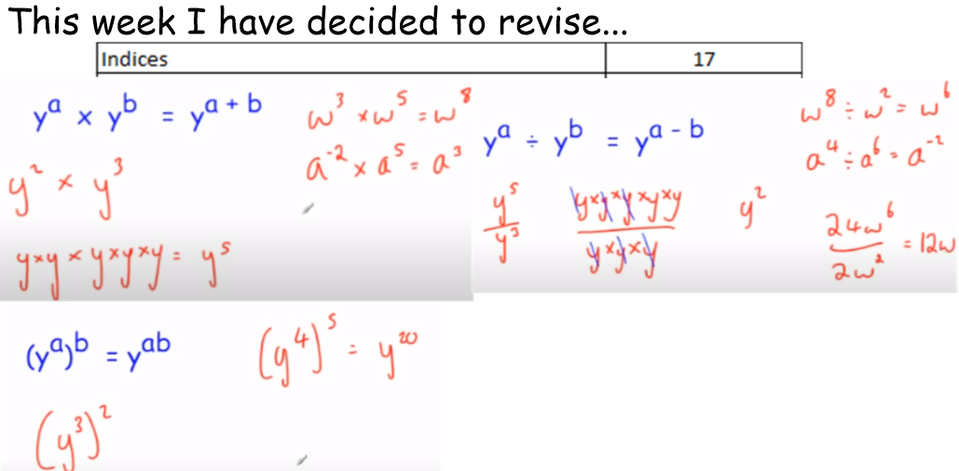
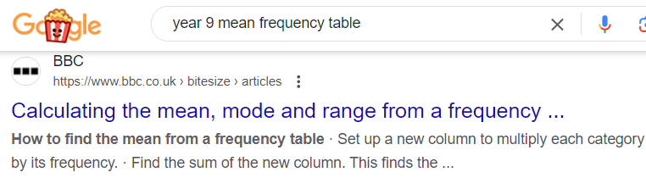
Support at home

Slide 11

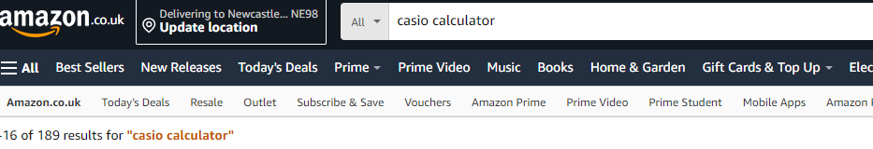
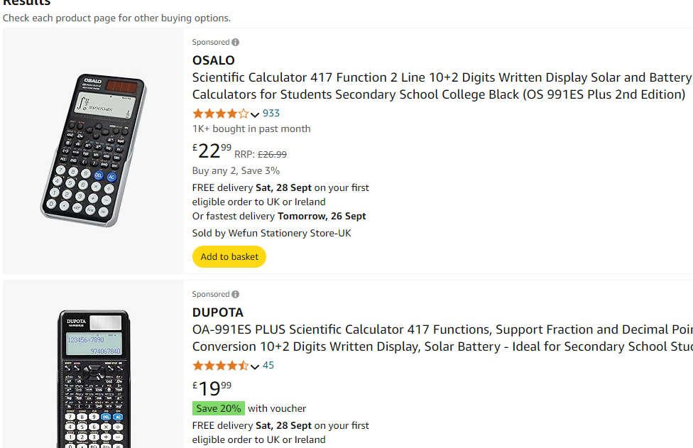

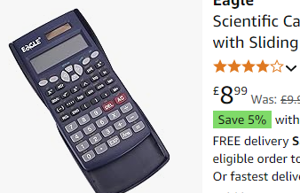
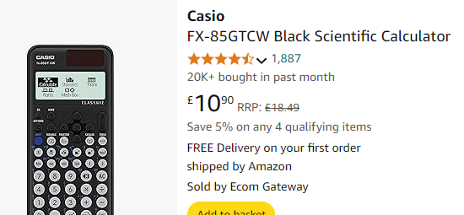
Useful resources
A calculator! (Casio FX-83, FX-85, FX-991)
Calculator familiarity is key at GCSE, and fairly crucial for much of year 8 and 9.
P
P

Slide 12

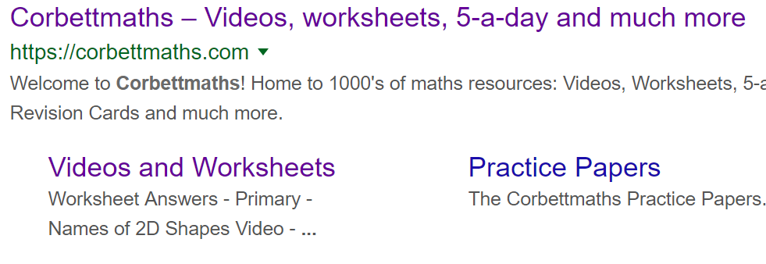
Useful resources
To support your child at home we encourage the use of Corbett Maths, Maths Genie and GCSE Bitesize
Free websites with video guides and practice worksheets

Slide 13
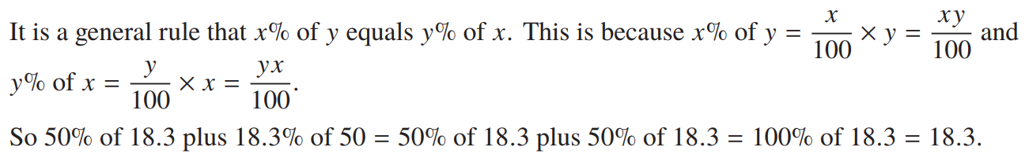
Thank you

