Slide 1


Supporting your child in Mathematics at Year 11

Slide 2
Mathematics in KS4
About the curriculum
Higher/Foundation and GCSE Grades
Assessments and Mocks
The Homework Booklet and Form Time
Supporting at Home
Useful Resources

Slide 3
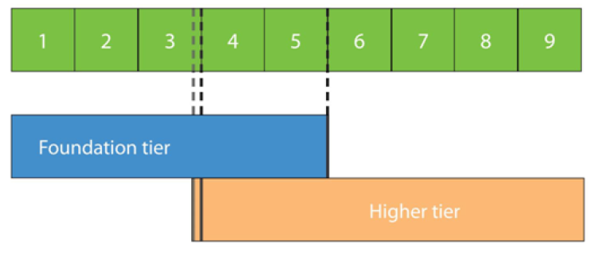
GCSE Tiers of Entry
We aim to enter pupils for the tier of entry that gives them the best chance of their highest possible grade
Entries are not made until after January Mocks in Year 11, assessments are carried out in year 10 and Year 11 to ensure pupils are covering the most appropriate work to support their attainment in the final GCSE exams – set changes are made throughout to ensure the most appropriate support is available.

Slide 4
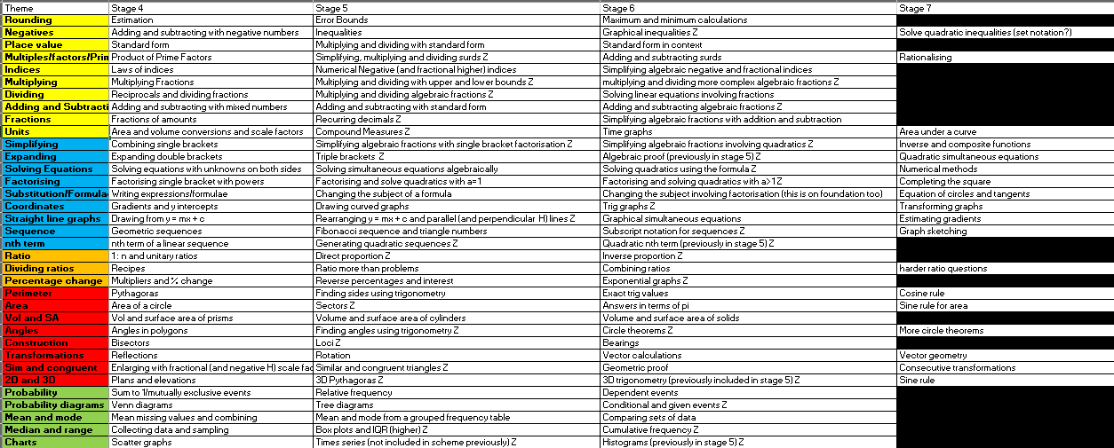
KS4 Curriculum Content (year 10 and year 11)

Slide 5
Assessments and mocks
In year 11 there are 4 full GCSE assessments, one in Autumn, two during the January Mocks, and one in Spring
We aim to enter as many pupils as possible for the Higher tier paper, but many “borderline” pupils stand a better chance of achieving a grade 5 on the Foundation paper.

Slide 6
AQA Further Maths
Only pupils who achieve a grade 8 or 9 in January mocks in year 11 will be entered for this extra exam
It will be an opt-in process, with the majority of the teaching taking place in Period 7 sessions.
Some of the overlap topics will be taught in mainstream lessons to pupils covering the Higher syllabus.
Helps bridge the gap to A-level but is not essential.

Slide 7
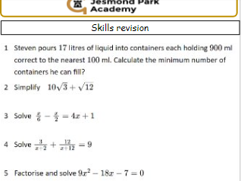
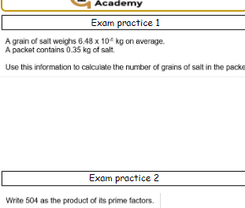
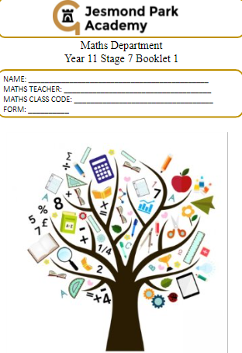
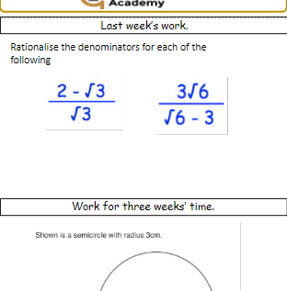
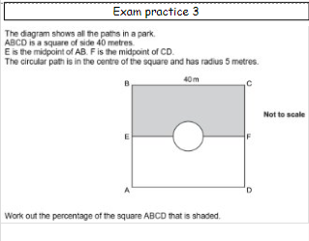
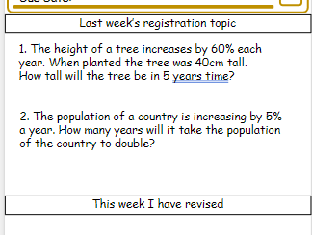
Homework (and form time) – At Year 11
All pupils have a booklet that is used for homework and during registration
They complete a supported revision programme during registration on Tuesday and Thursday
There are additional “Exam Practice” homework questions in the year 11 booklet to ensure breadth of coverage in the build up to the final exams – “little and often!”

Slide 8
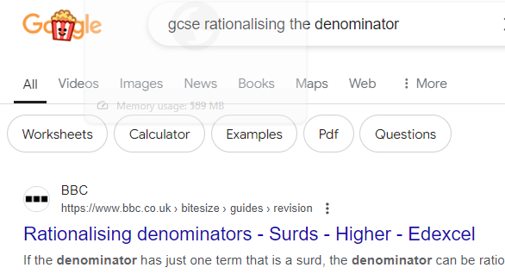
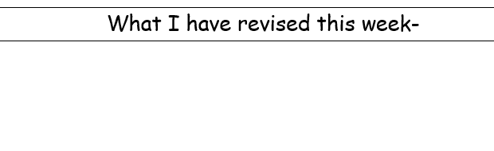
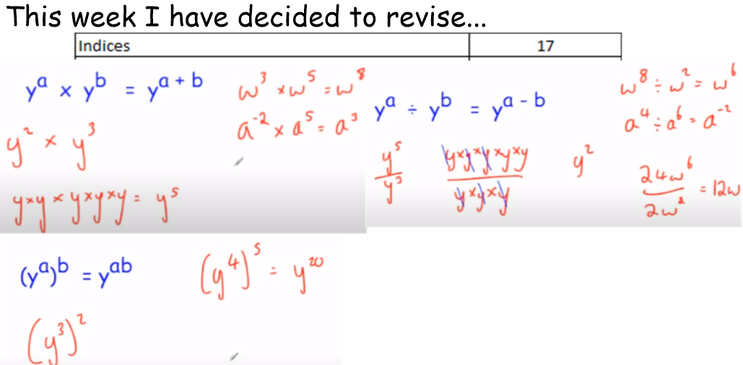
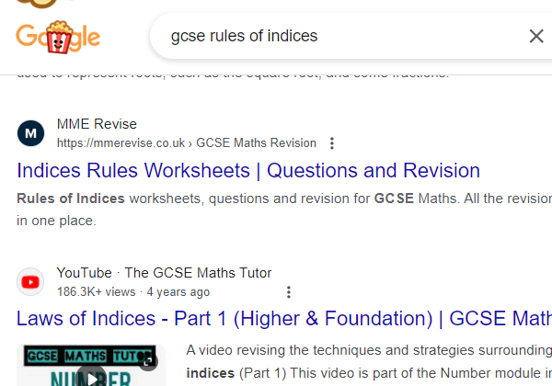
Support at home
- Make homework as purposeful as possible

Slide 9

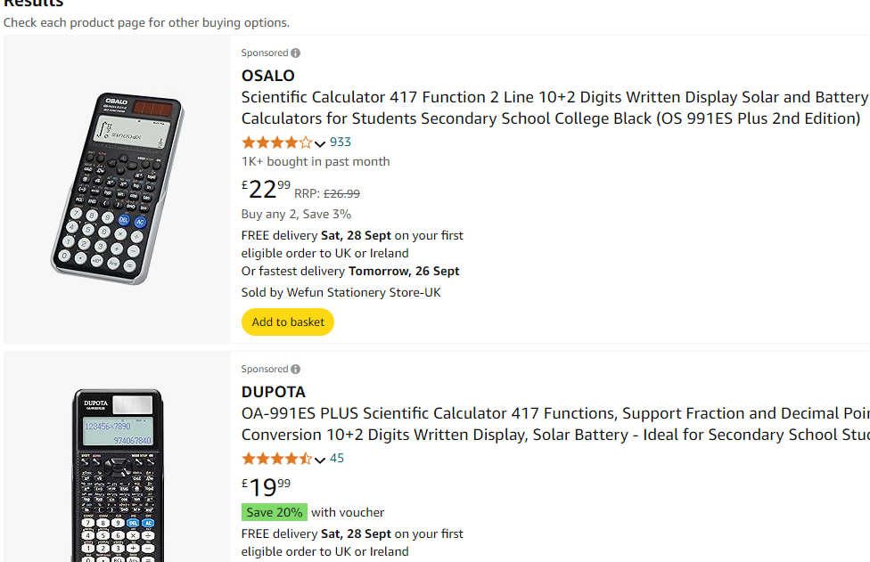


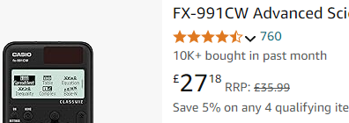
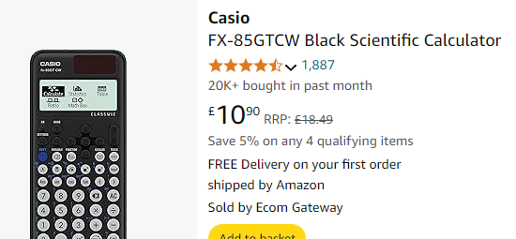
Useful resources
A calculator! (Casio FX-83, FX-85, FX-991)
Calculator familiarity is key at GCSE
P
Only get “991” if
likely to do
A-level:
P

Slide 10
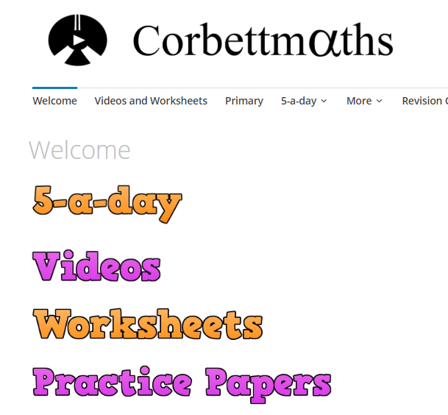
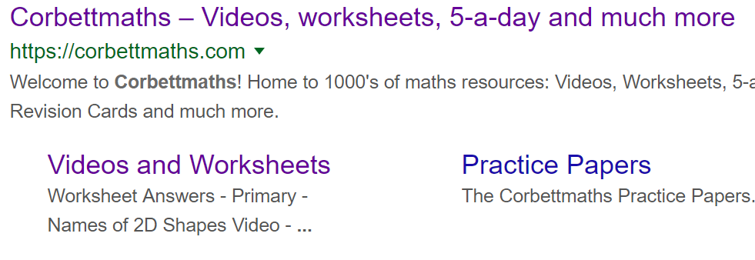
Useful resources – list on next page
To support your child at home we encourage the use of Corbett Maths, Maths Genie and GCSE Bitesize
Free websites with video guides and practice worksheets

Slide 11
Useful Maths Revision Websites
www.examq.co.uk/qualification/2
www.onmaths.com/our-top-top-topics
www.1stclassmaths.com
www.mathslinks.co.uk/gcse-questions-by-topic
www.gcsemathsquestions.co.uk
www.savemyexams.com/gcse
www.mathsgenie.co.uk
https://corbettmaths.com/contents/

