Slide 1


How to support your child in preparing for the English mock exam.

Slide 2
How have we prepared students for this mock exam?
The mock exam: English Literature Paper 2
Autumn 1 | An Inspector Calls- JB Priestley (English Literature Paper 2 Section A)
Autumn 2 | Power and Conflict poetry- focusing more closely on the 'conflict' poems. (English Literature Paper 2 Section B)
Coming up: Spring 1 | Unseen poetry and Literature Paper 2 revision (English Literature Paper 2 Section C)
Notes:
More details on the JPA website

Slide 3
We have carried out two other formal assessments:
What about the other GCSE components?
Autumn 1 | English Language Paper 1
Autumn 2 | English Literature Paper 1
Coming up: Spring 2 | English Language Paper 2
Notes:
More details on the JPA website

Slide 4
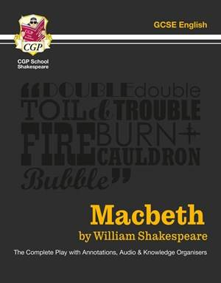
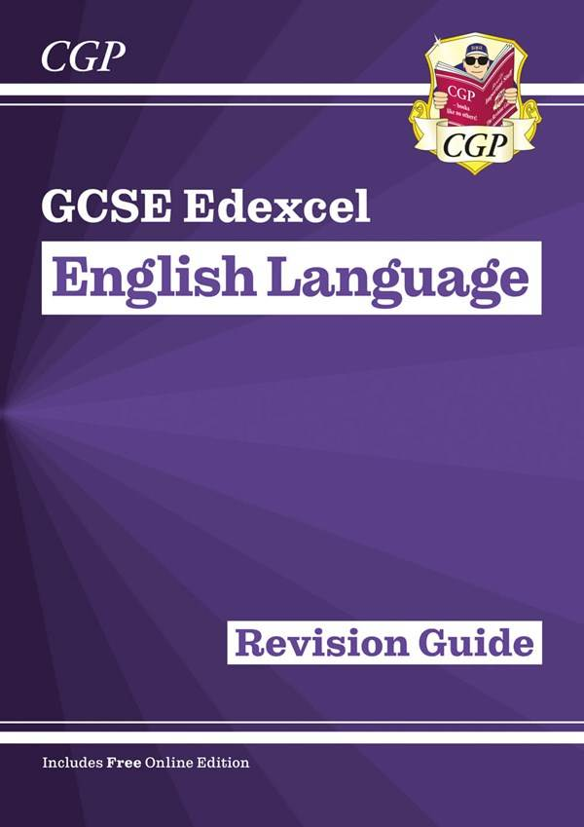
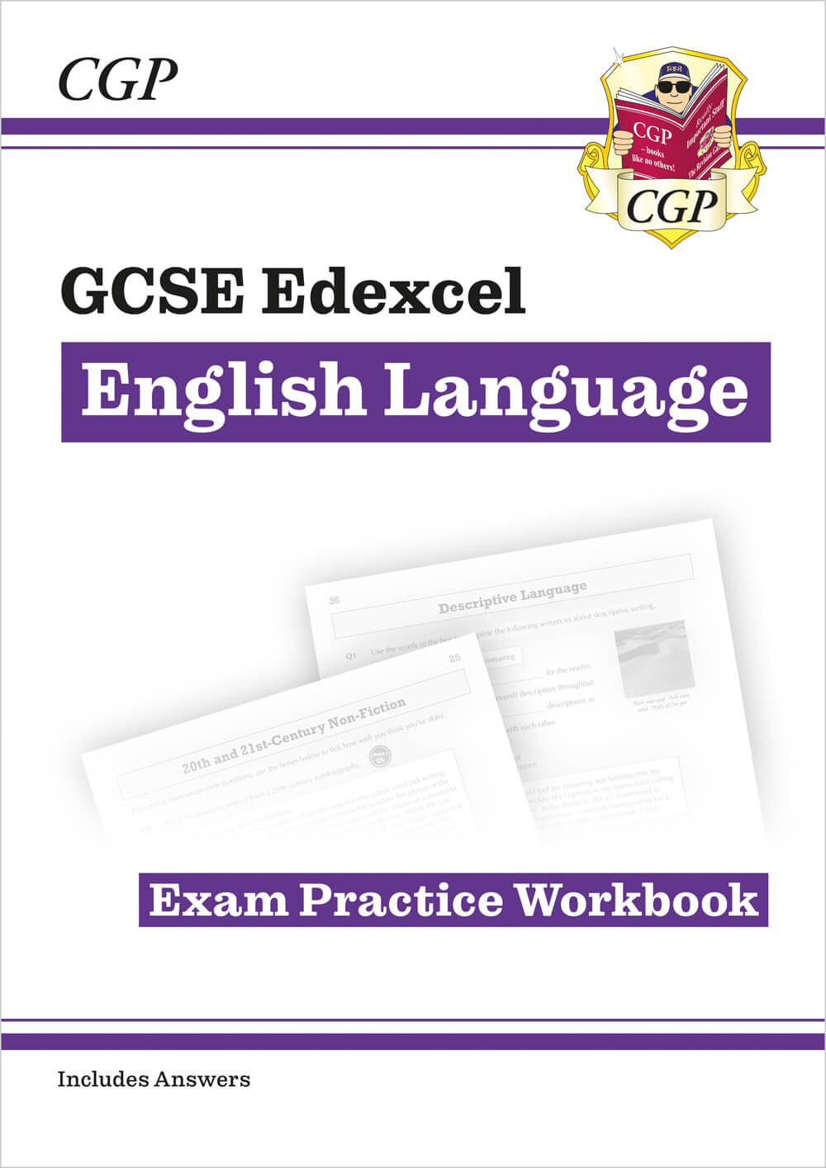
Revision Guides
Students have received:
English Language revision guides/workbooks
CGP revision guides on all Literature texts.

Slide 5
Period 7 offer this half term...
Larger English revision sessions: all students will receive an A3 resource as part of this session they can complete/continue to work on at home.
Smaller group sessions: focusing on key areas of the exam at teachers' discretion.

Slide 6
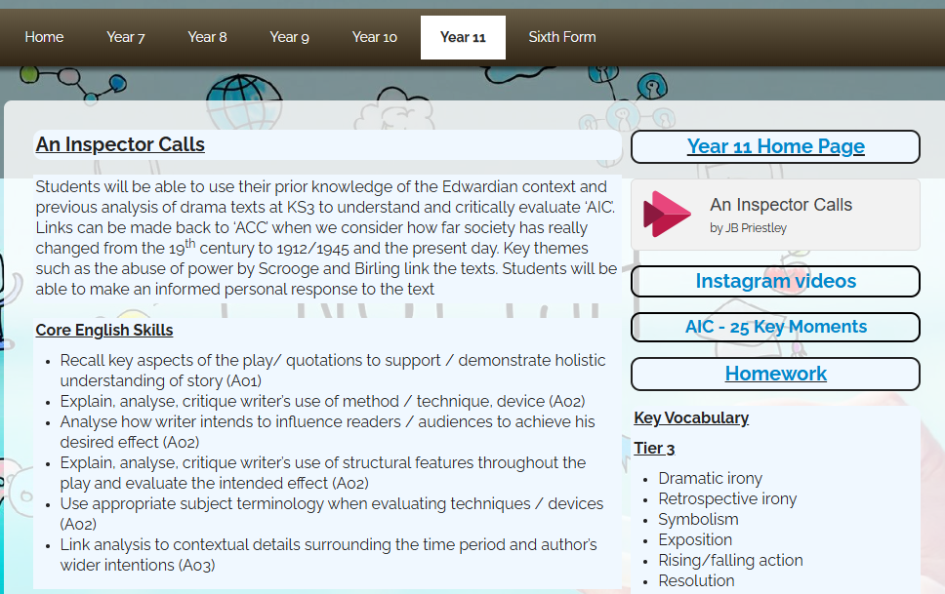
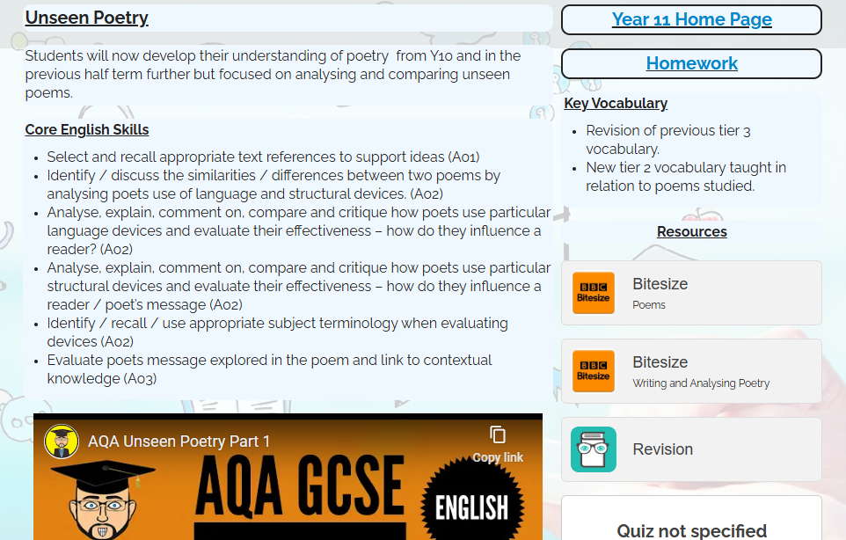
On the VLE:

Slide 7
How else will we support your child?
Literature Lectures
Previous topics include:
The Troubles and Storm on the Island
Macbeth and Freud
The Motif of Temperature in A Christmas Carol
Alcohol as a Symbol in An Inspector Calls
The Identity of a Soldier
Romanticism in Poetry
The Supernatural in A Christmas Carol
Stagecraft in An Inspector Calls
Patterns and Themes in Macbeth

Slide 8
Supporting your Child: Team English
Head of English: Jennifer Allsopp
English KS3 Co-Ordinator: Cally Lambert
English KS4 Co-Ordinator: Jonathan Clark
English KS5 Co-Ordinator: Spencer Taylor
Thank you for your support at home!

Slide 9
Exam Dates – Summer 2025
Monday 12th May | English Literature Paper 1 Macbeth and A Christmas Carol
Tuesday 20th May | English Literature Paper 2 An Inspector Calls and Poetry
Friday 23rd May | English Language Paper 1 Fictional Writing
Friday 6th June | English Language Paper 2 Non-Fiction Writing

