Slide 1

Supporting your child through the Y11 mock examination process

Slide 2

Mr. Merrifield deputy Principal

Slide 3
Exam dates
Y11 Mocks are scheduled for the two weeks beginning Monday 13th January.

Slide 5
Mr. Mason
Head of Key Stage 4

Slide 6
P7
Currently ongoing, all Y11 students have three compulsory guided revision sessions per week.

Slide 7
Exam timetables and Revision topic lists
Your child will be issued with the exam schedule and revision topic lists shortly.

Slide 8
Support through personal development lessons
PD lessons having been focused on effective revision techniques and strategies, to support study completed at home.

Slide 9
Mr. JAMES SMITH
Head of year 11

Slide 10
10 tips for coping with exam stress
1. Take regular breaks.
2. Don’t let friends wind you up.
3. Make a revision timetable
4. Eat well.
5. Give yourself a chance to get a good night’s sleep.
6. Use physical activity
7.Treat yourself.
8.Try relaxation techniques.
9. Don’t take part in the exam 'post-mortem'.
10. Keep a sense of perspective.

Slide 11




Slide 12
General Advice to all KS4 students
1. Keep it in perspective
2. Get that organised feeling
3. Get into some good habits
4. Get into school every day on time
5. Get support from family and friends
6. Ask if you need help

Slide 13
How will I know if my child is ready for the examinations?
Successful Students
Less Successful Students
Have a good subject knowledge
Have worked hard over an extended period of time, Y7-10
Follow their teachers and parents advise
Are well prepared
Are well organised
Are well rested
Are confident and relaxed
Take the process seriously
Try hard, never give up
Show perseverance after tough papers
Use their time productively
Know little about the subject they are studying
Do their own thing
Do not prepare or revise
Are disorganised with their timetable and preparation
Are burned out
Have wound themselves up and “stressed out”
Think that mocks or practices are unimportant (they will wait for the “real thing”)
Give up after one tough exam
They waste time

Slide 14
Young people do better academically at school if they are mentally and physically healthy.
To worry about exams is typical and “normal”.
Knowing how to deal with situations that might be stressful – like taking exams – equips them with skills vital for long term health and wellbeing, including knowing when to ask for help.
Every young person is different and what works for one might not be helpful for another.
What do we know?

Slide 15
What’s Typical behaviour during exams?
Reluctance to talk about school, study or anything to do with exams
Change in eating habits – more junk food / snacks / quick fix meals
Shutting themselves away in their bedroom as soon as tea is over.
Bad tempered and irritable / impatient
Worry and tears.
Change in sleeping habits
Reactive and rude. “Walking on eggshells”

Slide 16
When to Worry?
REFUSAL to talk about ANYTHING
Change in eating habits – NOT eating or BINGE eating
Shutting themselves away in their bedroom ALL THE TIME
Bad tempered and violent towards themselves, others or things
Worry and tears EVERY DAY.
Change in sleeping habits – NOT sleeping or ALWAYS sleeping
Rebellion – substance use / risk taking behaviour.
Decline in physical health – stomach aches / headaches

Slide 17
What to do to support your child?
Maintain agreed boundaries.
TALK TO SCHOOL if you are worried
Stay flexible. Allow negotiation.
Stay positive. Encourage perspective.

Slide 18
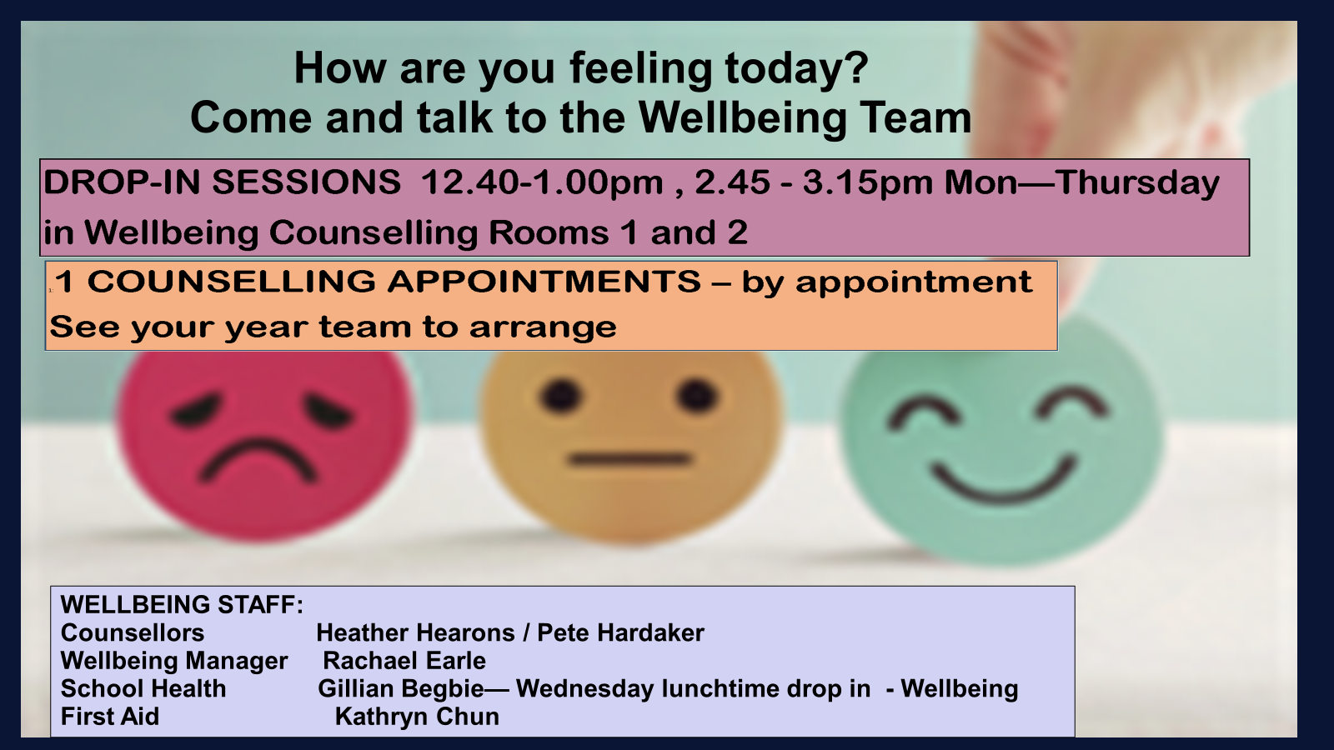

Slide 19
WHO CAN HELP?
YEAR TEAM – available throughout the day
HEAD OF YEAR: jsmith2@jesmondparkacademy.org.uk
YEAR MANAGER: mbooth@jesmondparkacademy.org.uk
KEY STAGE MANAGER: ghenderson@jesmondparkacademy.org.uk
Email the year team at any time with any concerns.
Year Team can arrange intervention and support quickly and discreetly whenever needed

Slide 20
WHO CAN HELP?
If you are struggling speak to one of the following:
FORM TUTOR – available every morning and after school
TEACHERS – available in lessons
ADULTS AT HOME – available whenever you need them
Don’t ignore your feelings – talk to someone and we can find a solution together

Slide 21
Nobody else can play the role that you do…
As Parent/Carer you can….
Reduce panic and anxiety in your child. Reassure them that if they are doing everything that is asked of them it will all be fine
You can read your child better than we can – you know what works.
Help them organise themselves into a routine.
Make sure they know when, where and what GCSEs they are entered for.

Slide 22
Preparing for the examinations

Slide 23
“if you keep doing what you are doing you will keep getting what you are getting”
Albert Einstein

Slide 24

If you are happy with your current results keep working the same way. If you want to improve in anything you must change something.
New way of studying, more sessions or more intense study.

Slide 25
“Don't mistake habit for hard work”
Shannon Sharpe

Slide 26

Revision is not sitting silently in your room with your books. Or doing the same thing over and over again.
Try as many other techniques as you can.

Slide 27
Some Revision Ideas
Complete Past Papers look for common/similar type questions
Past mark schemes
RAG past papers (looking for gaps)
Write notes
Read revision guides/notes
Use revision workbooks
Make flash cards
Record yourself
Teach someone else
Listen to pod casts
On line revision sites
GCSE Pod
Discussion with friends or family
Get someone to test you
Create a mind maps, spider diagrams, flow diagrams, numbered lists etc
Put posters/notes around the house – Key words, phrases, quotes, equations

Slide 28
Mr. Mason
Head of Key Stage 4

Slide 29
Suggestions for effective revision

Slide 30
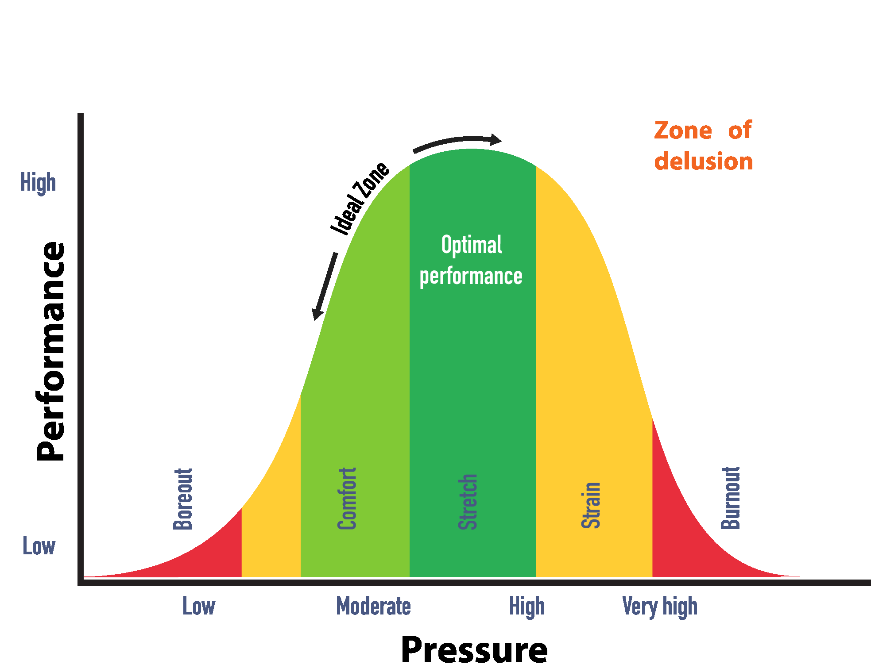
Getting in the right frame of mind
1. Advice for effective revision

Slide 31
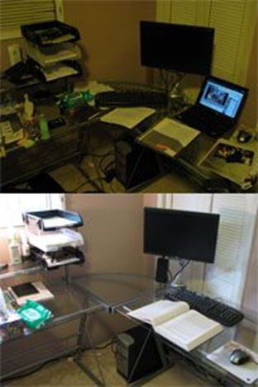
5-step revision plan
1. Advice for effective revision
Focus
Prepare a distraction and ‘clutter’ free study area with everything needed (study materials and equipment).
Good lighting, no music and no mobile.
Drinks and snacks

Slide 32

5-step revision plan
1. Advice for effective revision
Keeping in the Flow - what not to do
Copy from a textbook/exercise book
Do nothing with the information.
Try and cram ‘too much information’
Highlight information for the sake of it
Pay enough attention to a task e.g. distractions and multitasking
Comfort zone revision

Slide 33
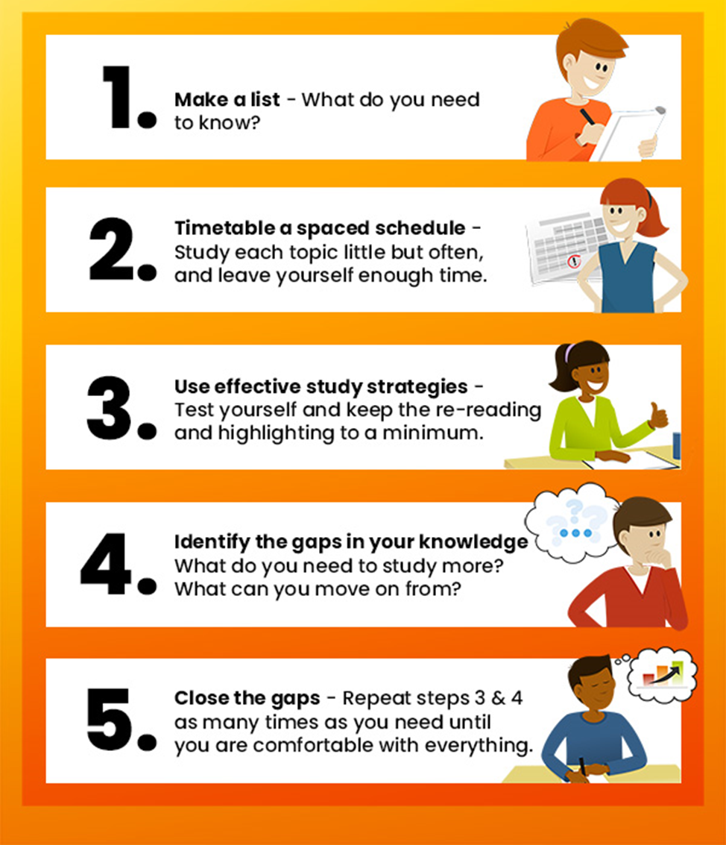
5-step revision plan
1. Advice for effective revision

Slide 34
5-step revision plan
1. Advice for effective revision
This may simply be a list of your subjects- you may not need to do anything more than look at your timetable and exam schedule.
However, you may want to prioritise your list in someway - areas of highest need

Slide 35
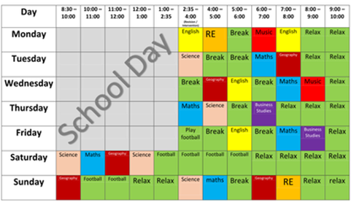
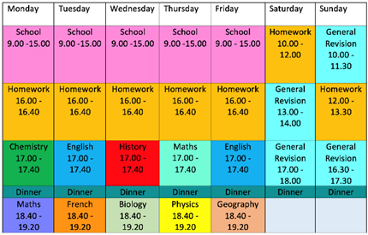
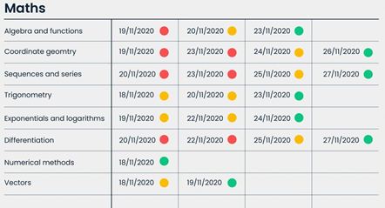
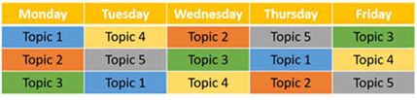
5-step revision plan
1. Advice for effective revision

Slide 36
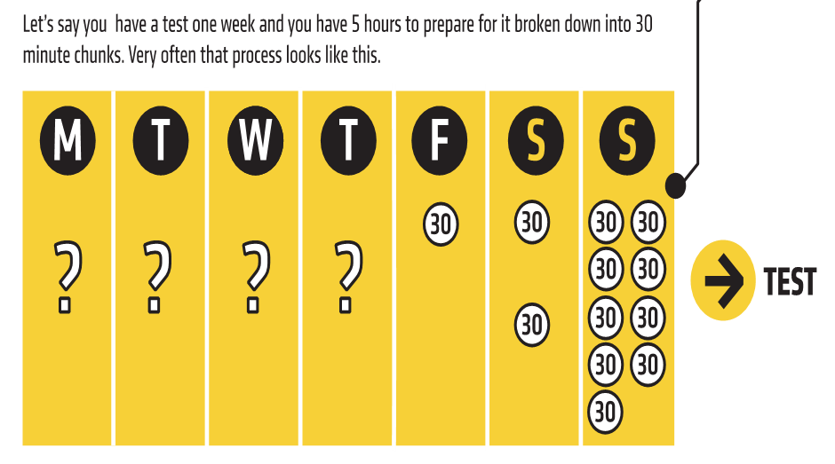
5-step revision plan
1. Advice for effective revision
Massed
vs
Spaced Learning

Slide 37
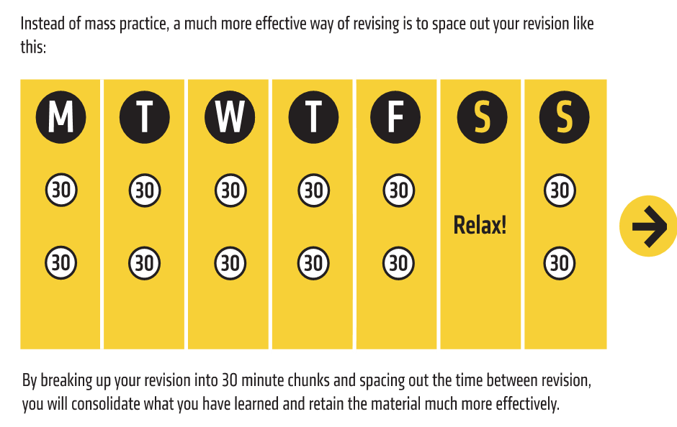
5-step revision plan
1. Advice for effective revision
Massed
vs
Spaced Learning

Slide 38
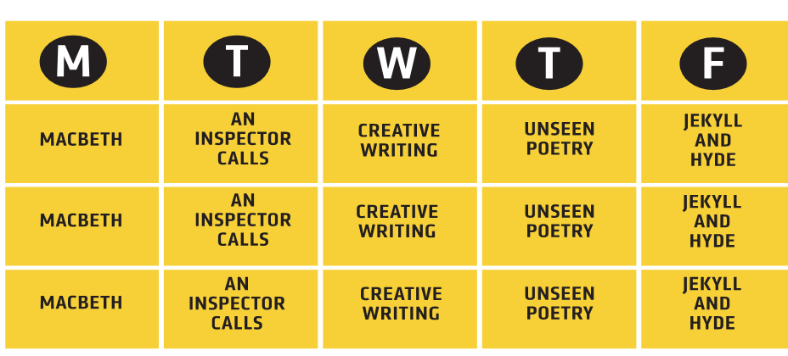
5-step revision plan
1. Advice for effective revision
Blocking
vs
Inter-
leaving

Slide 39
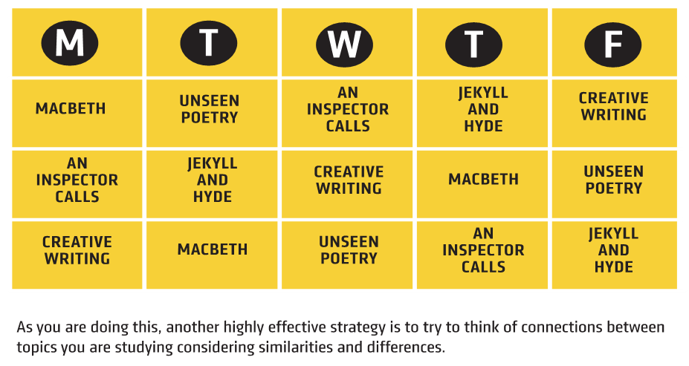
5-step revision plan
1. Advice for effective revision
Blocking
vs
Inter-
leaving

Slide 40
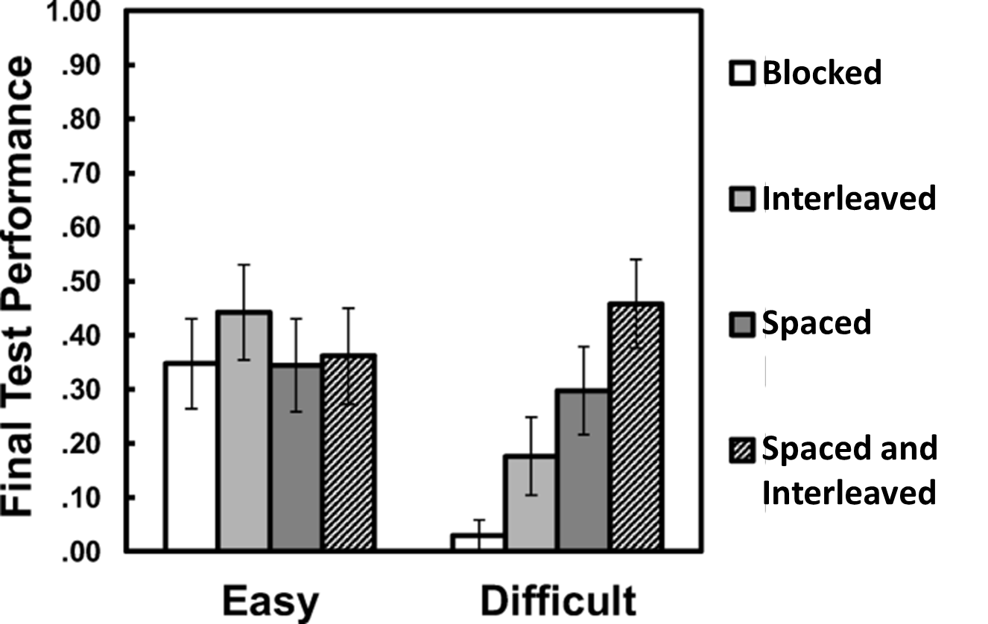
5-step revision plan
1. Advice for effective revision
Evidence

Slide 41
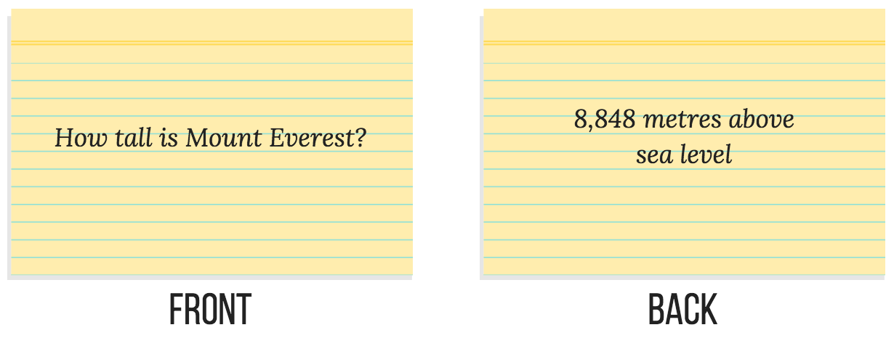
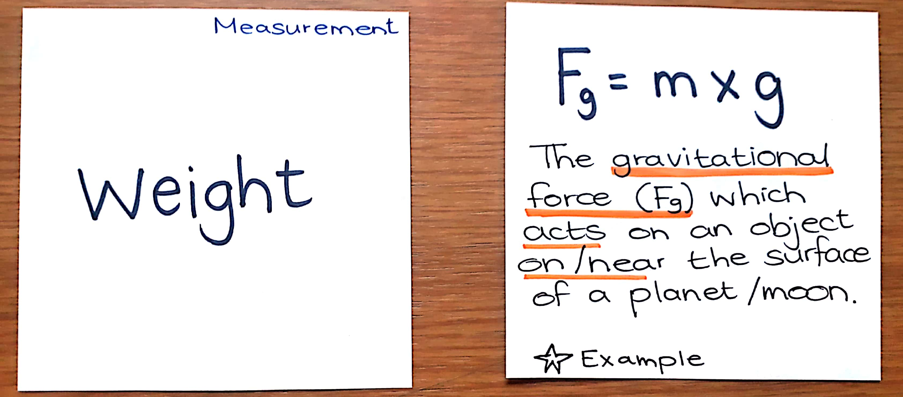
5-step revision plan
1. Advice for effective revision
Flash cards
Q and A
Topic and key facts
Keep text to a minimum use memory tricks e.g. diagram, mnemonics, rhyme, etc.

Slide 42
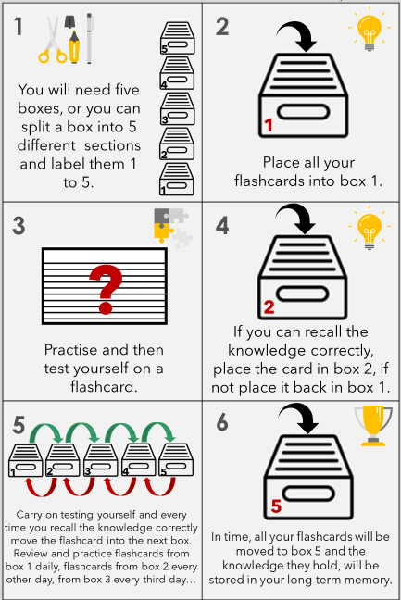
5-step revision plan
1. Advice for effective revision
Leitner System

Slide 43
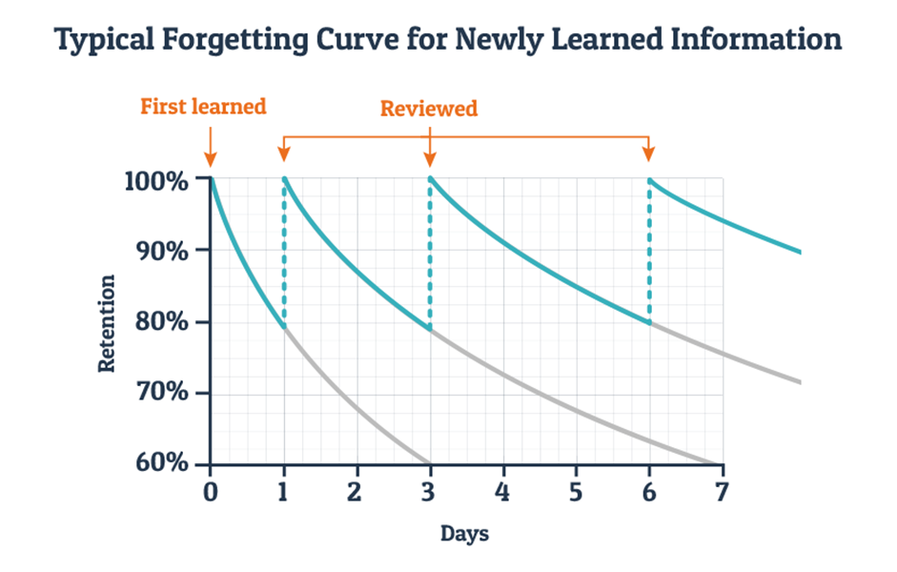
5-step revision plan
1. Advice for effective revision
Leitner System

Slide 44
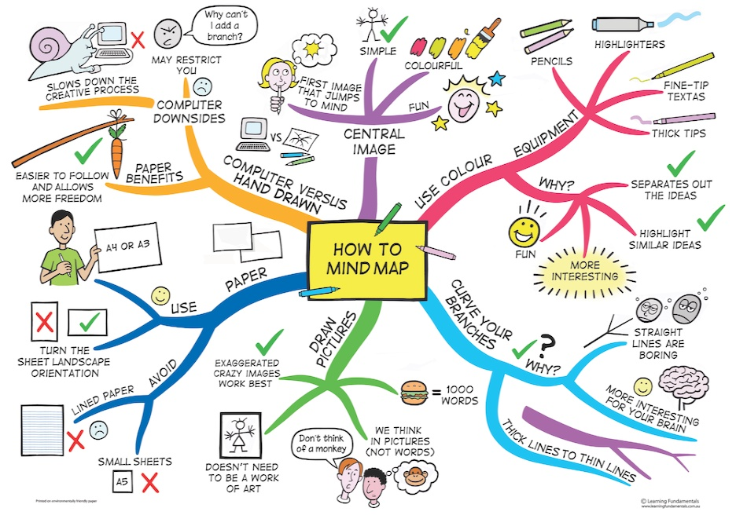
5-step revision plan
1. Advice for effective revision
Mindmaps

Slide 45
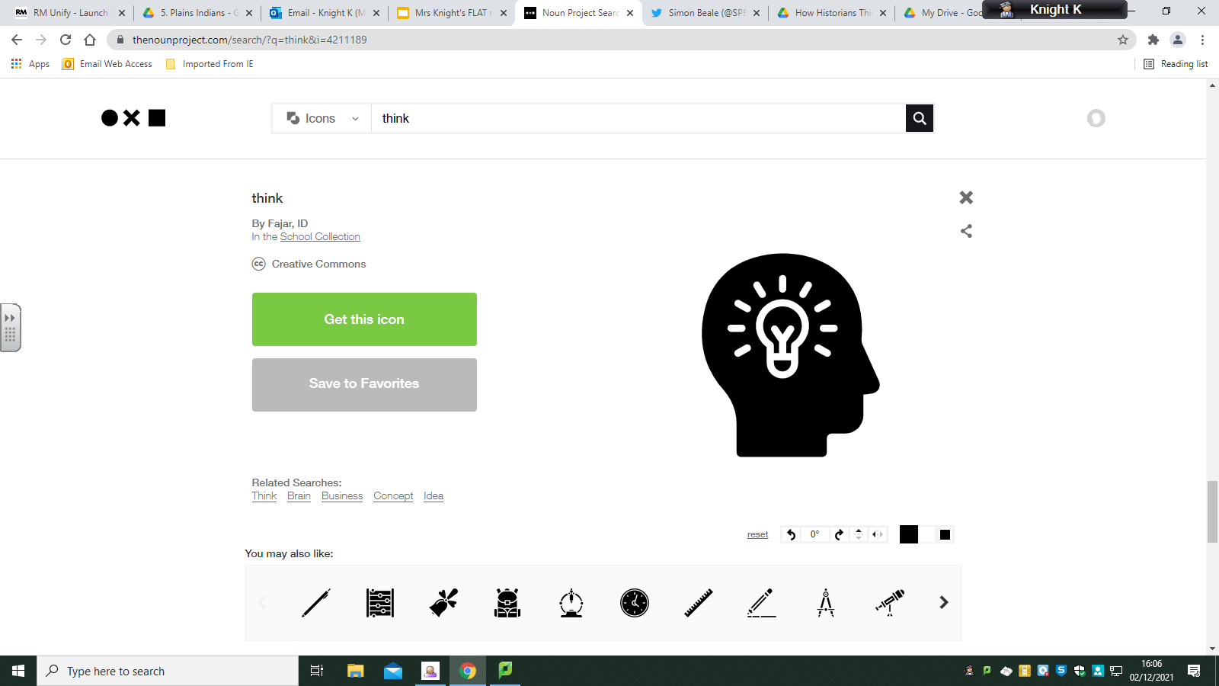
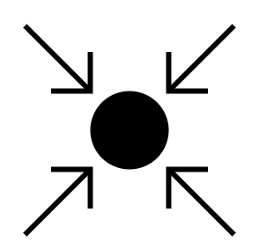
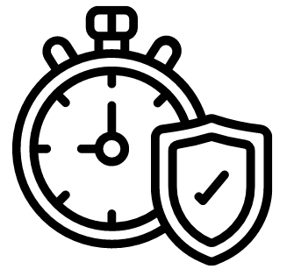
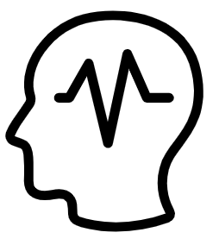
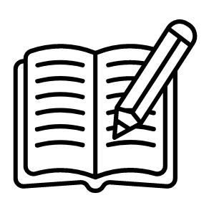
Is your revision FLAT?
FOCUSED
LONG-TERM
ACTIVE
TRANSFORMED
Put your phone away
Turn the music off
Avoid distractions
Be in the right physical place to revise
Be in the right frame of mind to revise
Start early to cut down on stress later in the year
Make a revision timetable and commit to it
Plan for 90 minutes to 2 hours study
Interleave different topics
Engage your brain by actively creating revision resources
Test yourself, get others to test you
Practise exam technique by writing or planning answers
Revise what you struggle with
Transform the knowledge you want to learn into a different format
Make flashcards
Produce a timeline
Record a podcast
Invent a mnemonic
Create a mindmap
Design a flowchart
Make a powerpoint
Teach it

